Slide 1

Open a restaurant
in New York City,Brooklyn

Slide 2
Business Problem
My customer want to make some investment in New York city,Brooklyn.He prefer to open a restaurant in Brooklyn,but he is a new man for Brooklyn,here is the business problem and I have to address and fix it for my customer:
No idea about Brooklyn
No idea about which food Brooklyn people favorited
No idea about the restaurant location should be choosed

Slide 3
Data Description
Using data summary:
Brooklyn venues data from Foursquare
Data Description
Find the most hot neighborhood in Brooklyn by checking the number of venues.
Base on the hot neighborhood,find the most popular food the people liked.
Check the popular restaurant location distribution.
As people of neighboring area like similar type of food,choose the location which opend few above restaurant,but the nearby location have lots of same type restaurant.

Slide 4
Methodology
As customer no idea about Brooklyn,we have to figure out below two things:
Restaurant Location
Restaurant Type
We could achieve that by following steps:
Cluster the venues on neighborhood level
Get the top popular neighborhoods
Analyze the venues construction of above neighborhoods
Find the most popular type of food of the popular area
Open the most popular restaurant in corresponding location

Slide 5
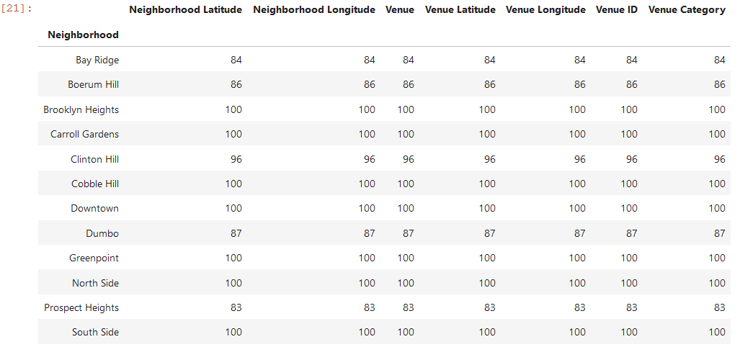
Location analyze
The hot area must have a lots of venues,I cluster the venues for each neighborhood then choose the neighborhood where the number of venues over than 80 as the candidate location:

Slide 6
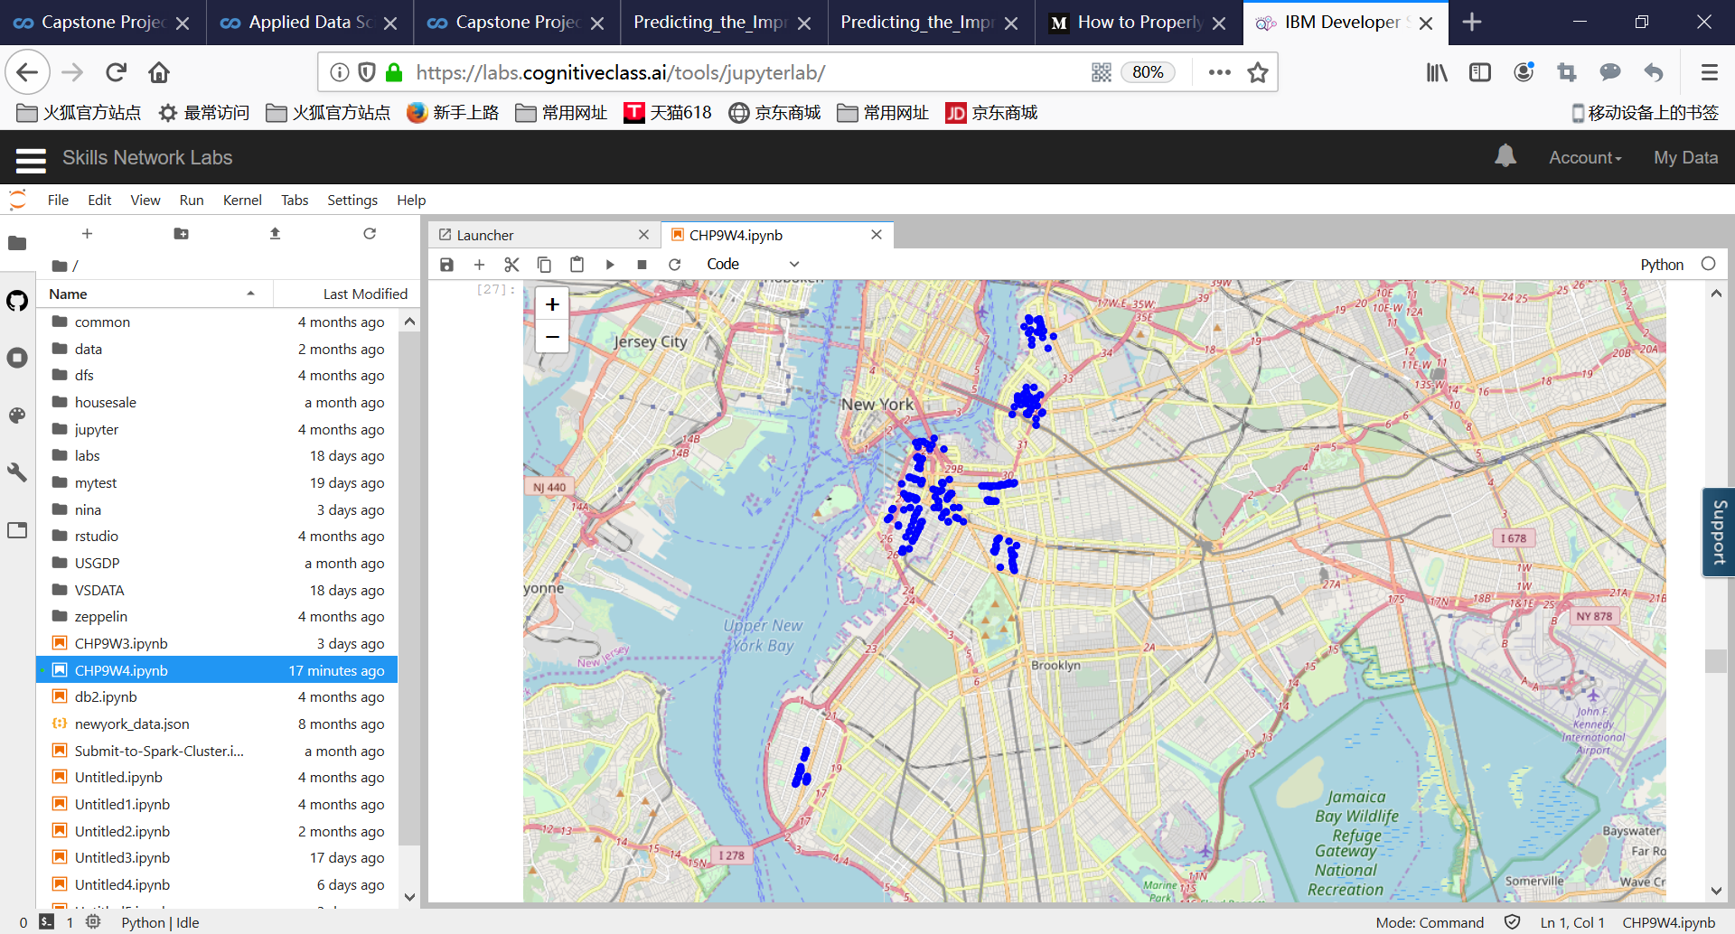
Restaurant analyze-1
Cluster the Restaurant type by Venue category,then we know there are total 300 restaurant in hot Neighborhood of Brooklyn ,and here is the restaurant distribution:
Obviously,the North West is very hot,let's make some further analyzing

Slide 7
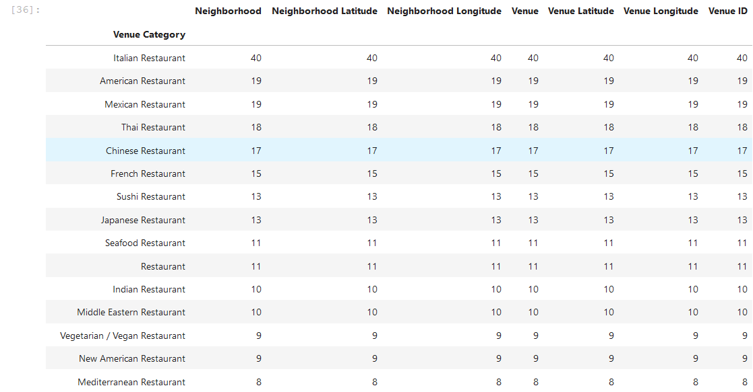
Restaurant analyze-2
Now we know the most popular food is Italian food,let's open a Italian Restaurant:

Slide 8
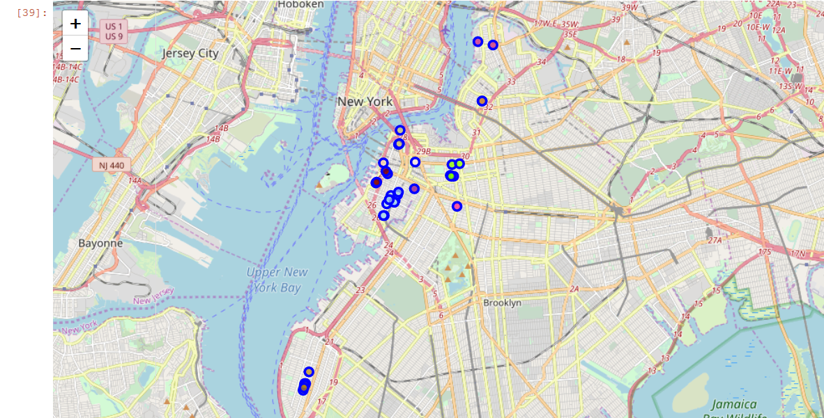
Final Result-1
I check the Italian Restaurant distribution and cluster the different Neighborhoods with different colors:
Boerum Hill

Slide 9
Final Result-2
From above map,we know that hot Neighborhood Boerum Hill is located at center of
the hot area and neighboring area already opened lots of Italian restaurant,but Boerum Hill only have one Italian restaurant,so this is a good location of our restaurant.
So I will suggest my customer to open a Italian restaurant in Boerum Hill.

